Slide 1
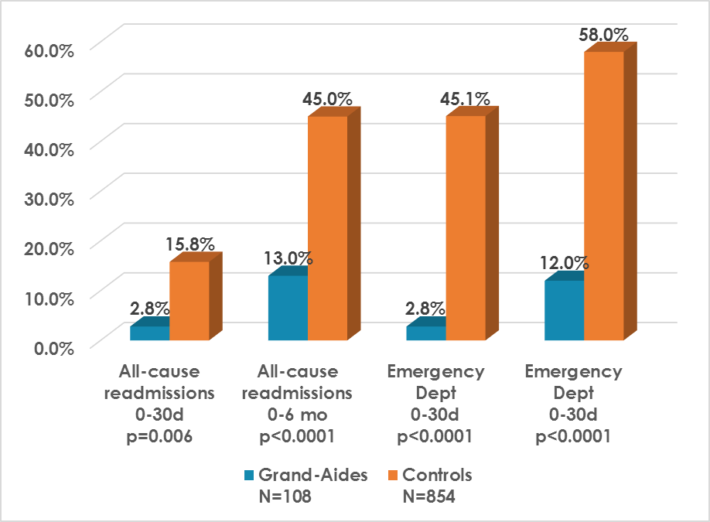
Heart failure patients with Grand-Aides have significantly fewer all-cause readmissions and Emergency Dept visits
University of Virginia 2017

